Slide 1
Three-dimensional facial landmark detection in 3D Photos
Luca Carotenuto

Slide 2
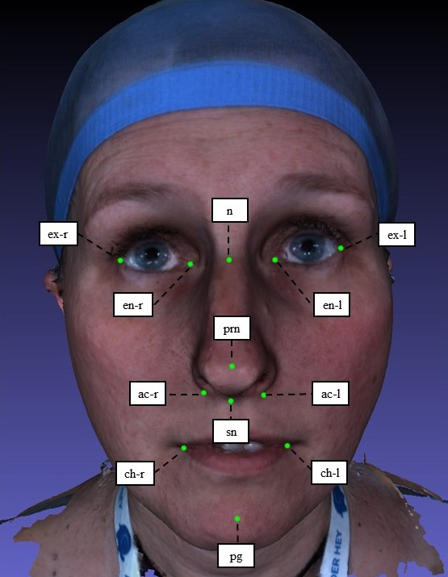
Problem
3D Lab, Oral and maxillofacial surgery
Manual landmark placing is tedious and inconsistent
High inter- and intraobserver variability
Notes:
3D Lab, Department of Oral and maxillofacial surgery
Oral and maxillofacial surgery involves reconstructive operations on the head, face and jaw as well as facial cosmetic surgery. Landmarks are being used during the planning, follow-up and diagnostics of surgical interventions.

Slide 3
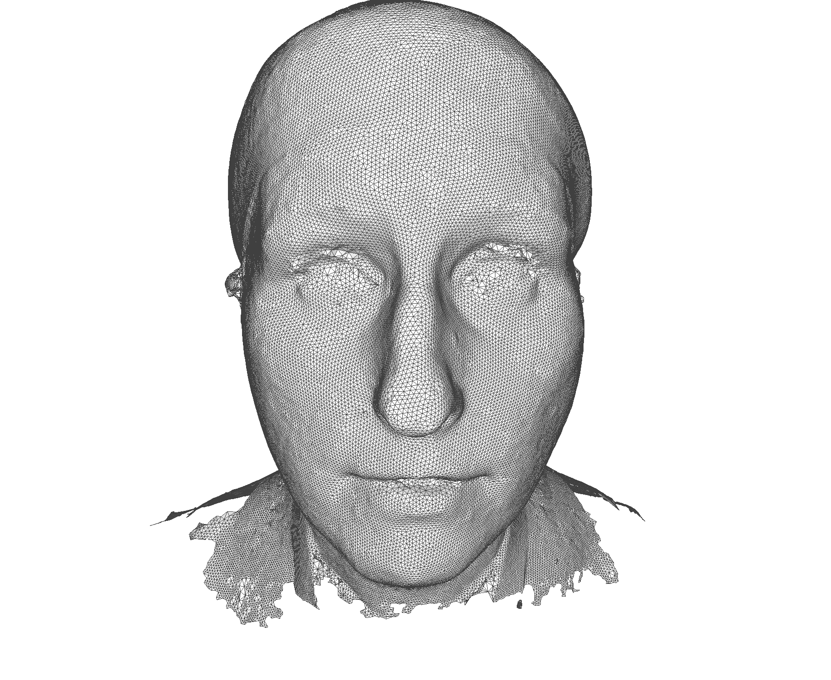
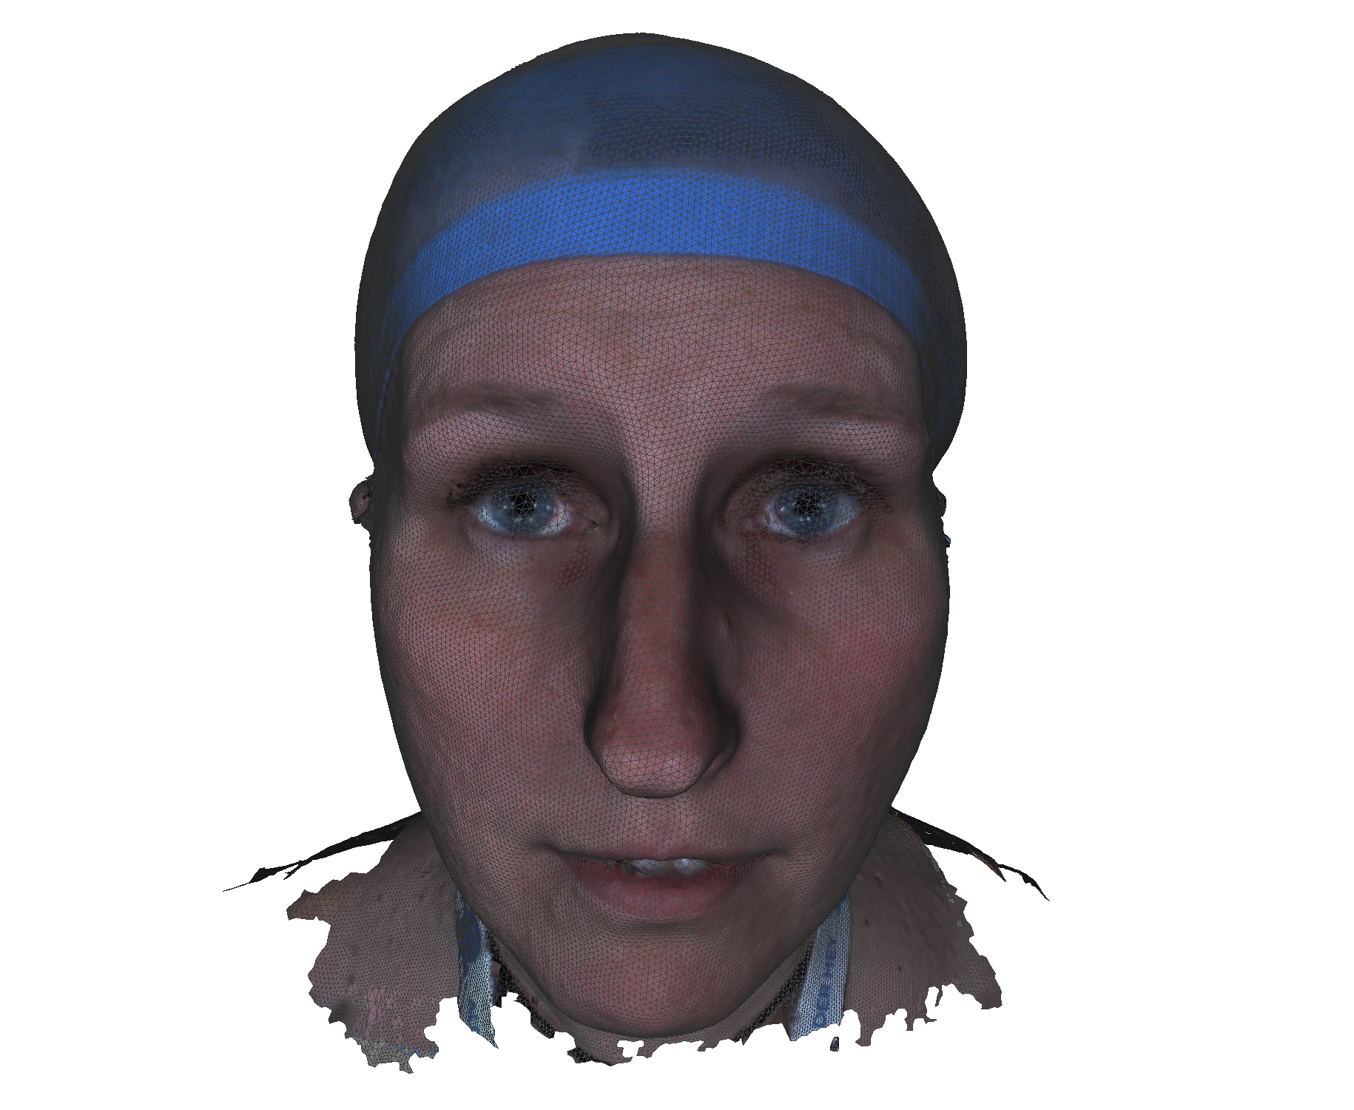
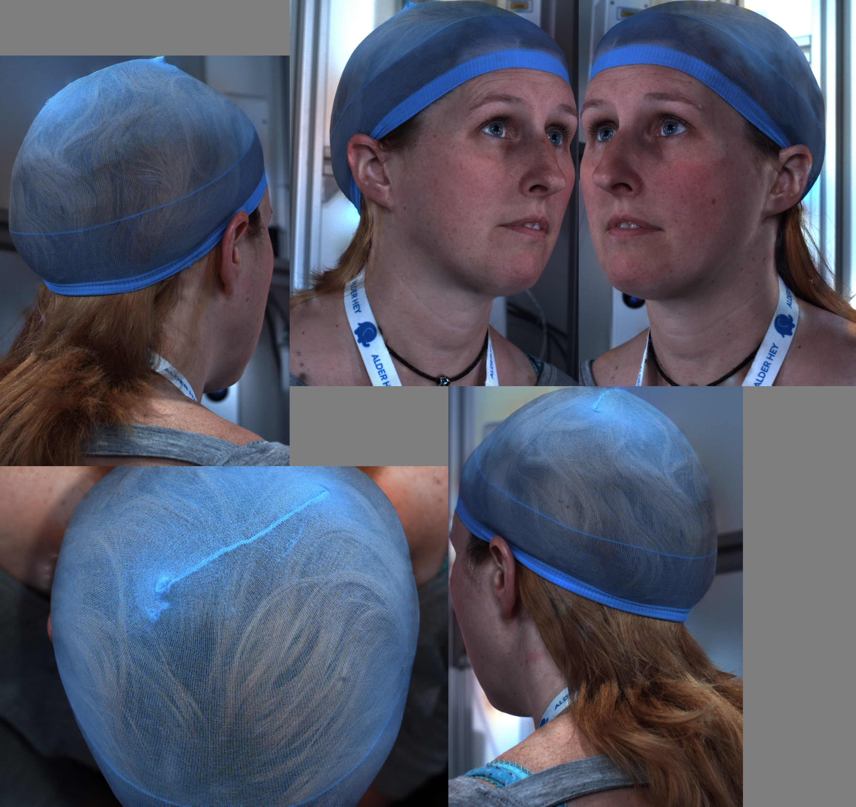
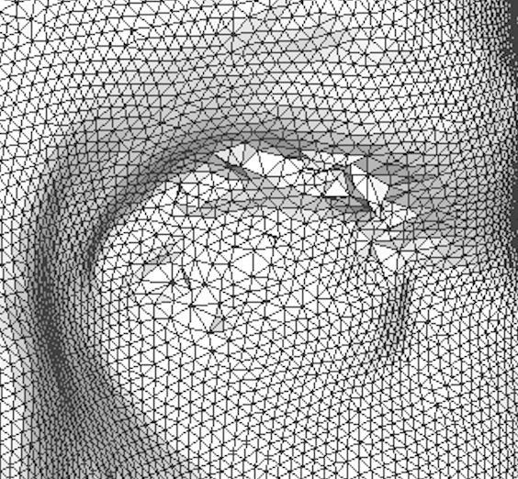
Stereophotogrammetry
triangulated surface: V, F, E
with texture
Notes:
Photo captured by 5 cameras, 2 frontal, 2 rear, 1 above
Mesh reconstructed

Slide 4
Data
Headspace data set: 3D Meshes of entire head
1200 annotated samples (Zhu-Ramanan mixture of trees algorithm + 3D projection)
307 manually annotated Headspace samples (2 annotators)
Variability between Headspace and manual labels: 3.81mm
Notes:
Around 1200 samples with annotation: Zhu-Ramanan mixture of trees algorithm with sub- sequent 2D to 3D projection
Manually annotated 307 samples (two annotators, each did half of the annotations)
Mean variability of 3.81mm suggests Headspace labels are noisy/inaccurate. (healthy inter observer variability 1.5mm)

Slide 5
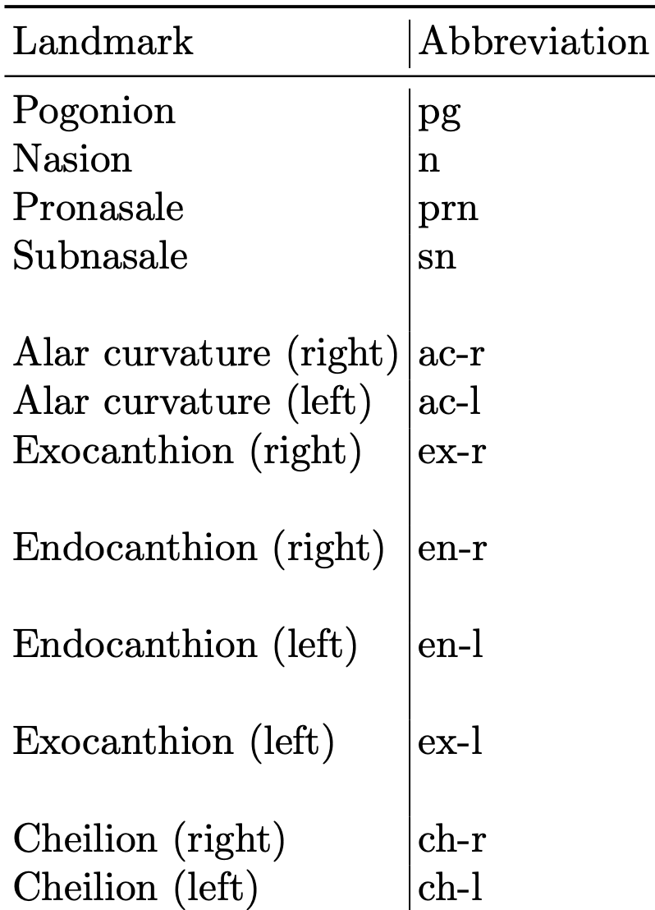
Notes:
Headspace labels: 68 landmarks, many non-anatomical, hard to define
12 anatomical landmarks, meaningful/medically definable

Slide 6
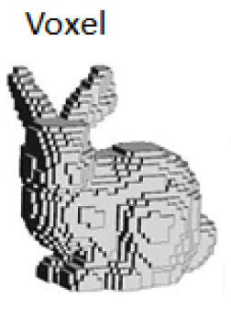
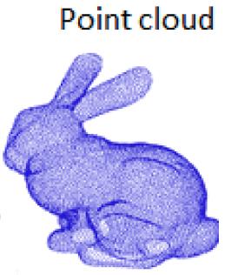
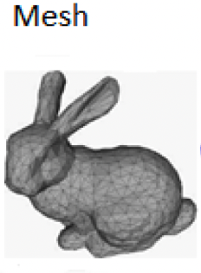
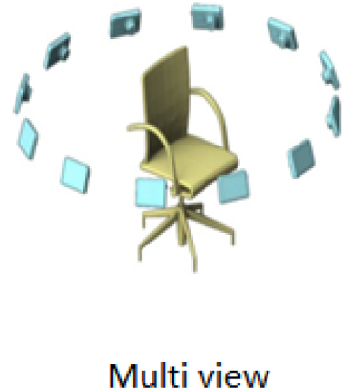
3D Deep Learning
Data representations:
Multi-view
Voxel
Point cloud
Mesh
Images from Gezawa, Abubakar & Zhang, Yan & Wang, Qicong & Yunqi, Lei. (2020). A Review on Deep Learning Approaches for 3D Data Representations in Retrieval and Classifications.
Notes:
Most literature about 2D facial landmarking: generative models, CNN on 2D images
Difficulty for 3D: different representations
Multi-view: 2D images taken from views in different angles, apply CNN to each, pooling to combine features; Drawback: information loss in reconstruction to 3D, illumination differences, object occlusion
Volumetric approaches: voxelize into grid (smallest unit is fixed-size voxel), can apply 3D convolutions; drawback: information loss by discretization, complexity grows cubically (high computation times and memory footprint)
Point Cloud: (1) irregularity: points irregularly sampled (sparse/densely occupied regions); (2) unstructuredness: distance between points not fixed (unlike Multiview or voxel which lie on grid); (3) unorderedness: permutation invariance, points can be shuffled without changing the point cloud
Mesh: graph based methods can be applied, Networks specialized for surface-based learning such as MeshCNN rare

Slide 7
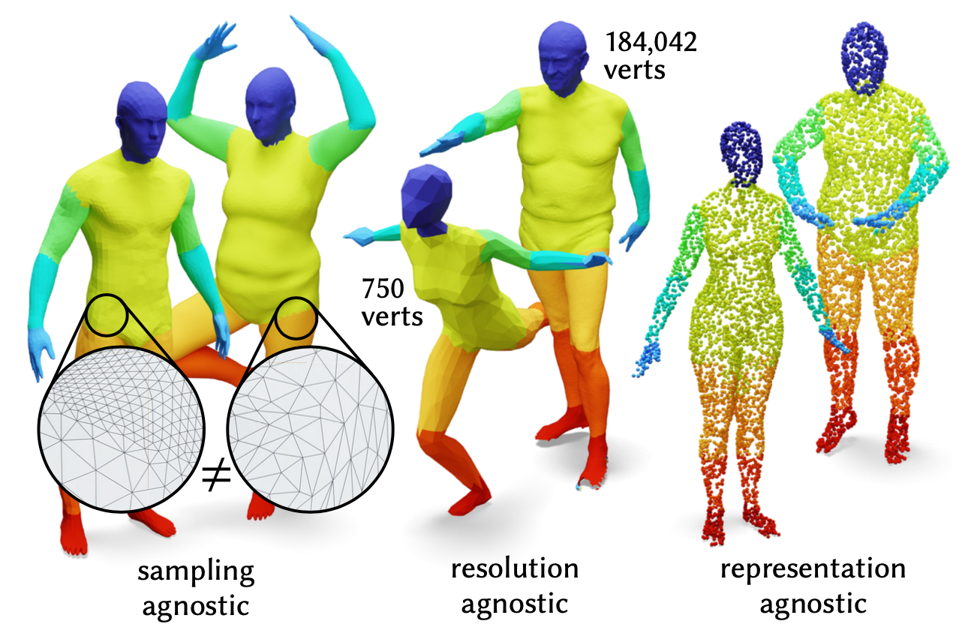
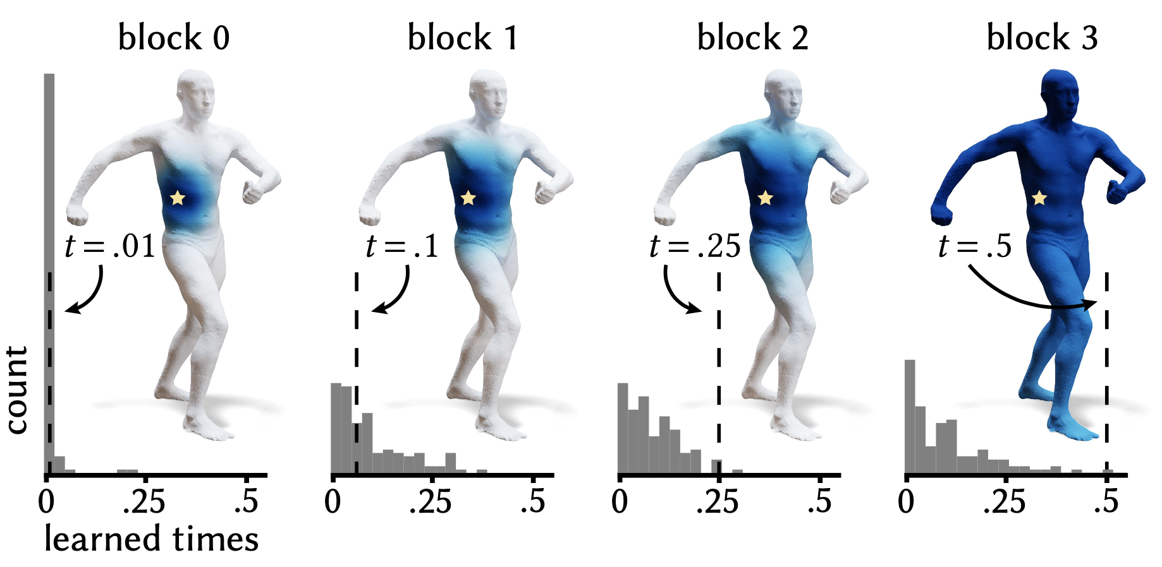
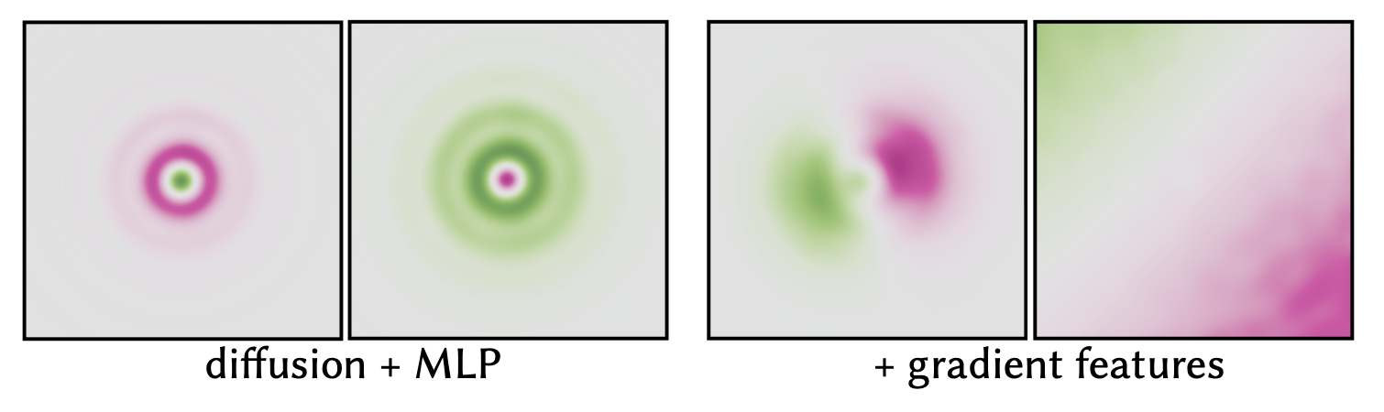
DiffusionNet
Surface learning
Components:
Per-vertex MLP
Diffusion
Spatial gradient features
Nicholas Sharp et al. “DiffusionNet: Discretization Agnostic Learning on Surfaces”. In: ACM Trans. Graph. 01.1 (2022).
Notes:
Sampling independent: can deal with irregular sampling in mesh/pcl
resolution independent: does not overfit on high/low resolution
representation independent: can train on point cloud, apply model on meshes or vice versa
(claims, how much they hold discuss later)
Diffusion: is used for communicating information across points
diffusion time defines local or global support (receptive field), similar to average pooling, block 0 local diffusion, block 3 almost global diffusion
different time for each channel, time is learnt so not necessary to manually set as e.g. for convolutional kernel size or pooling size
Local spatial gradient features, main purpose, to expand the network’s filter space beyond radiallly- symmetric filters to directional filters

Slide 8
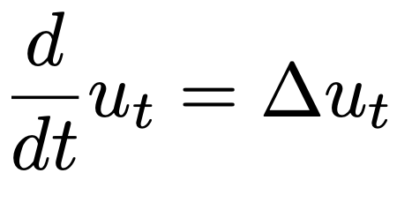
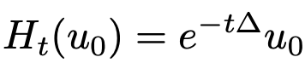
Diffusion
Heat equation:
u: scalar field
t: time
Δ: Laplace(-Beltrami) operator
Action of diffusion:
Discretization: replace Δ by weak Laplace matrix L and mass matrix M
Numerical scheme: spectral acceleration
Notes:
partial differential equation that describes the distribution of heat or temperature in space (scalar field u) over time
Laplace–Beltrami operator is a generalization of the Laplace operator to functions defined on submanifolds in Euclidean space

Slide 9
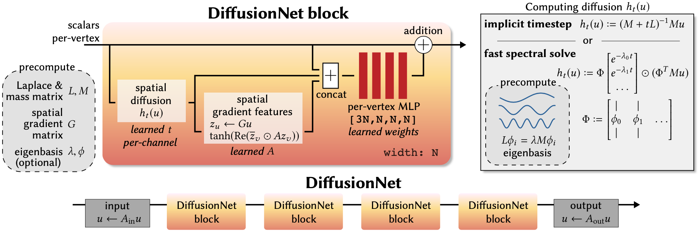
Architecture
V x N
V x N
V x 3N
V x N
Input: V x F V: Vertices F: Input features
F = 3 for XYZ
F = 6 for XYZ + RGB
F = 16 for Heat Kernel Signature (HKS)
N: Block width
Output: V x l
l: landmarks
V x N
V x N
V x F
V x l
Linear layer
in: F
Out: N
Linear layer
in: N
Out: l
Based on Nicholas Sharp et al. “DiffusionNet: Discretization Agnostic Learning on Surfaces”. In: ACM Trans. Graph. 01.1 (2022).
Notes:
Operators precomputed, otherwise training time very long
HKS: 16 values logarithmically spaced between 0.01 and 1
Block width / Number of features
Skip connection: simple addition

Slide 10
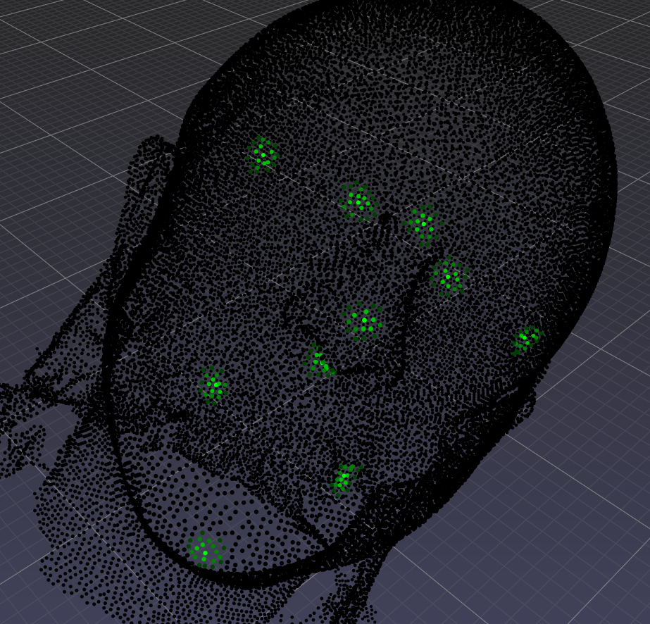
Data Preparation (Initial Network)
Point-wise regression approach
Points in landmark regions are assigned higher activations (increasing towards center)
Downsampled point cloud: 30k vertices (avg. vertex distance 2.2mm)
Notes:
Original resolution: 100-200k vertices
Downsampling done by simplification in pymeshlab (python interface for 3d processing software meshlab)
Own channel for each landmark

Slide 11
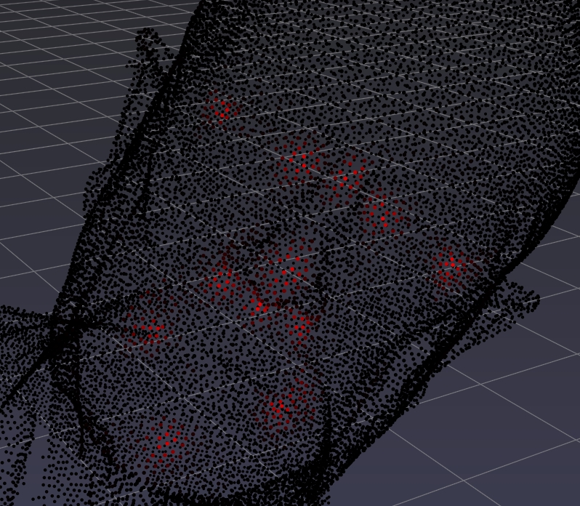
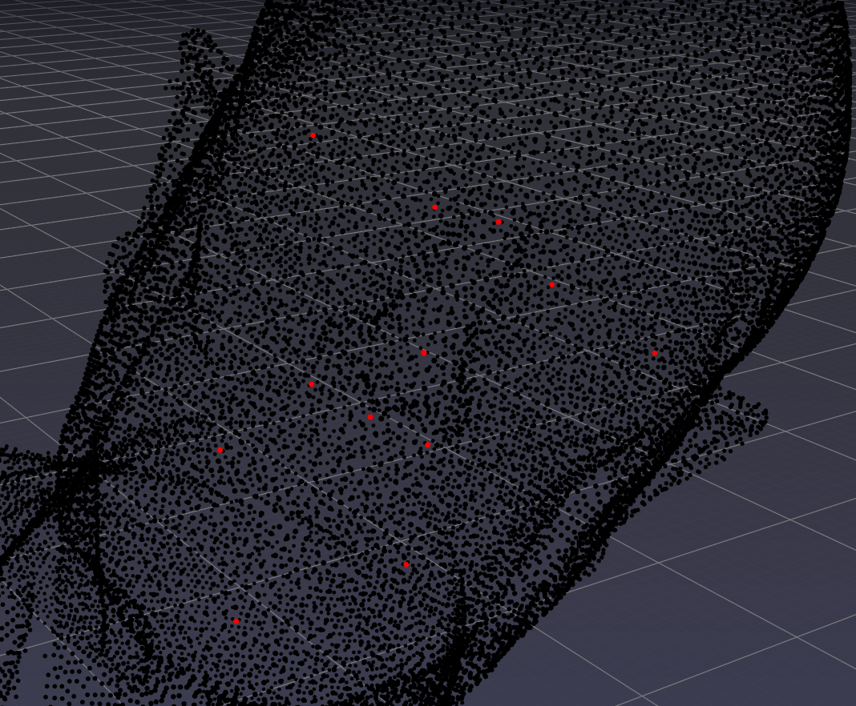
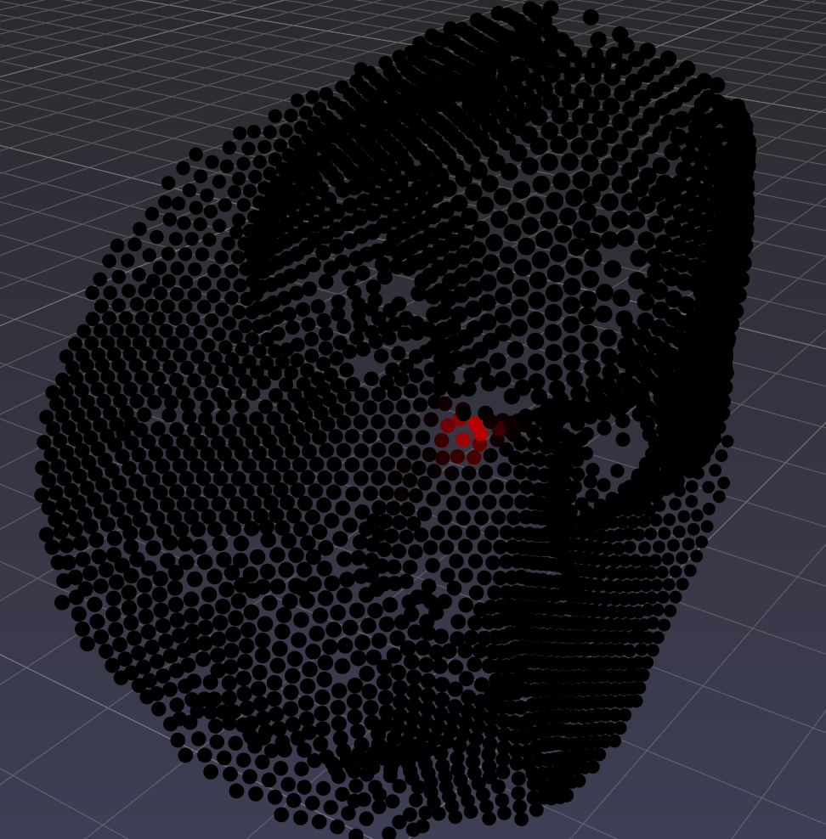
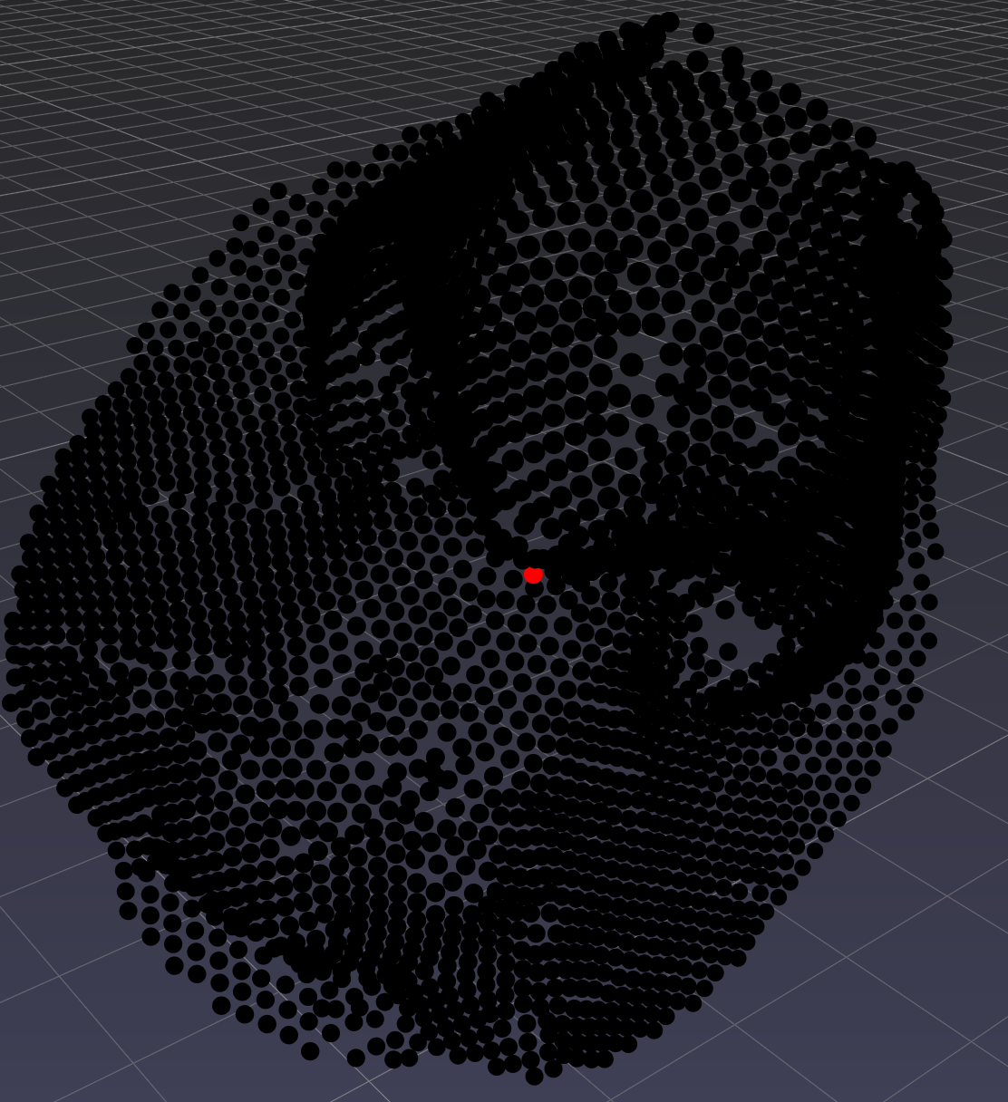
Refinement Pipeline
For each landmark
Initial Network
argmax
Refinement Network
argmax

Slide 12
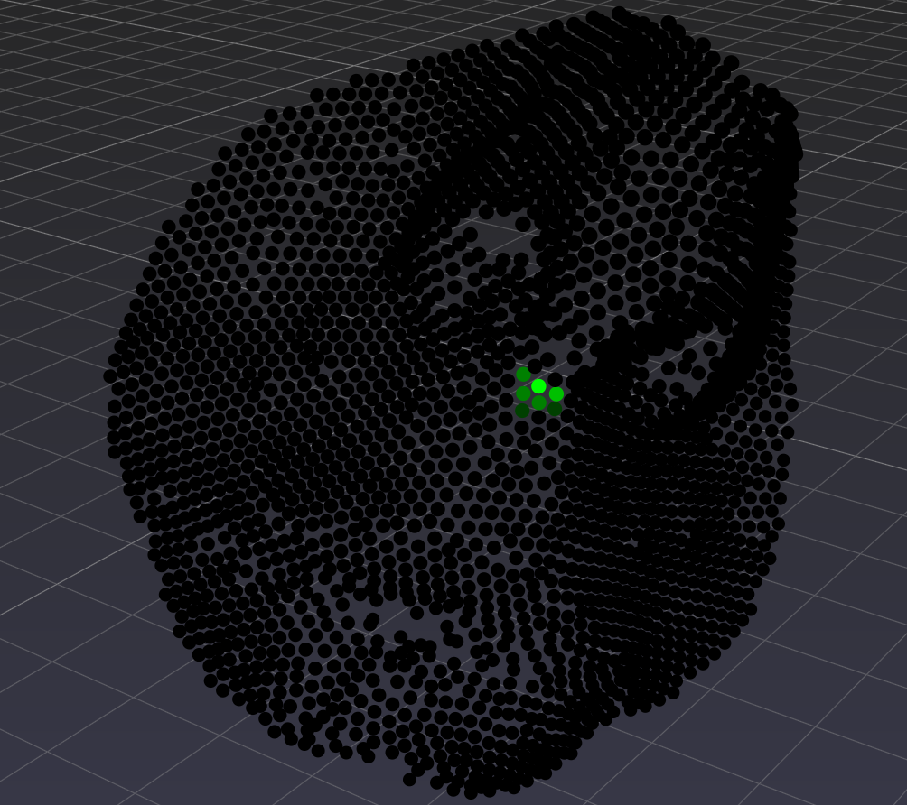
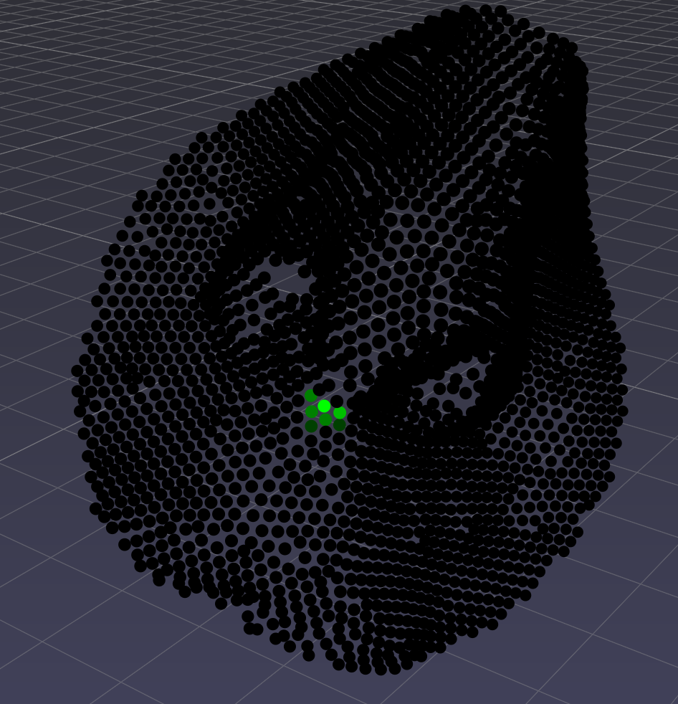
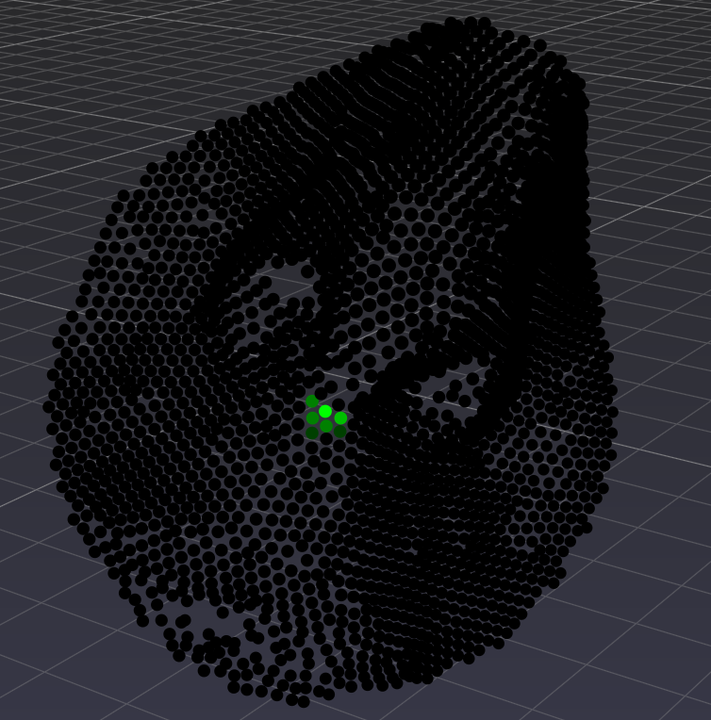
Data Preparation (Refinement Network)
Sphere in full-resolution: 1-2k vertices (avg. vertex distance 1.0mm)
Radius r = 2.5cm (1) and r = 3.0cm (2)
3 samples with varying jittering j = 3mm (1) and j = 6mm (2)
Notes:
Jittering in each direction

Slide 13
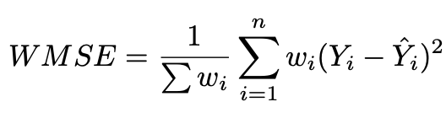
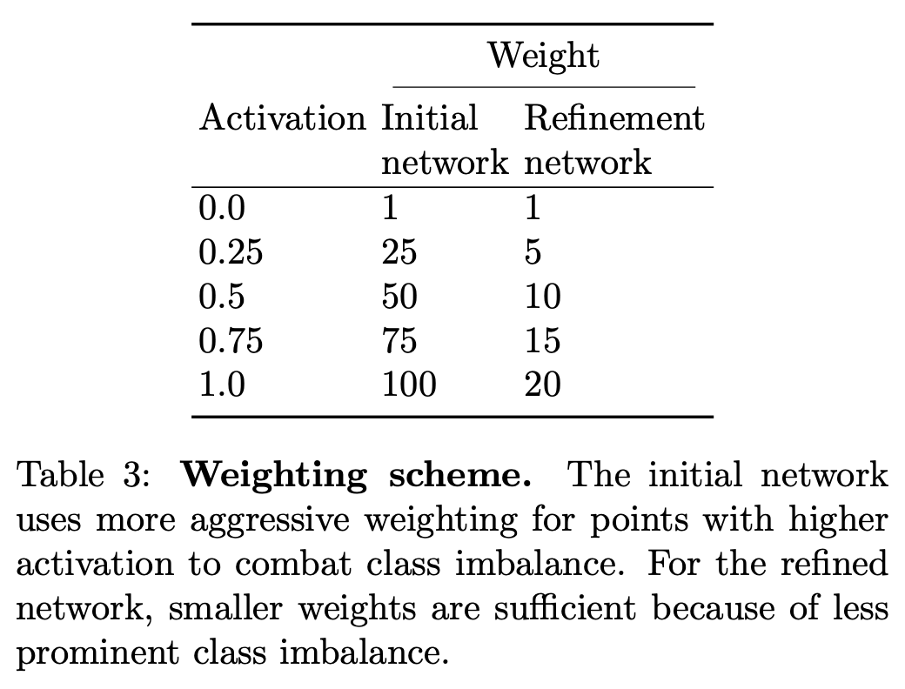
Weighted Mean Squared Error

Slide 14
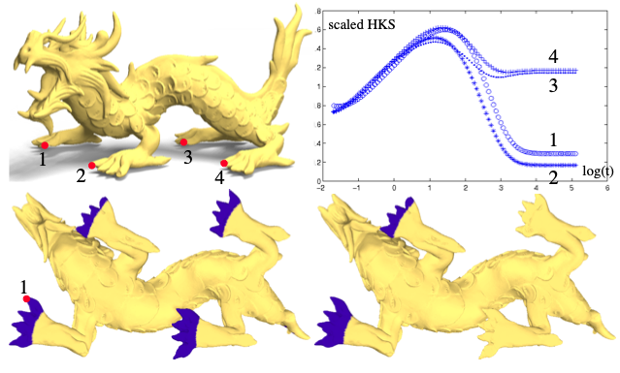
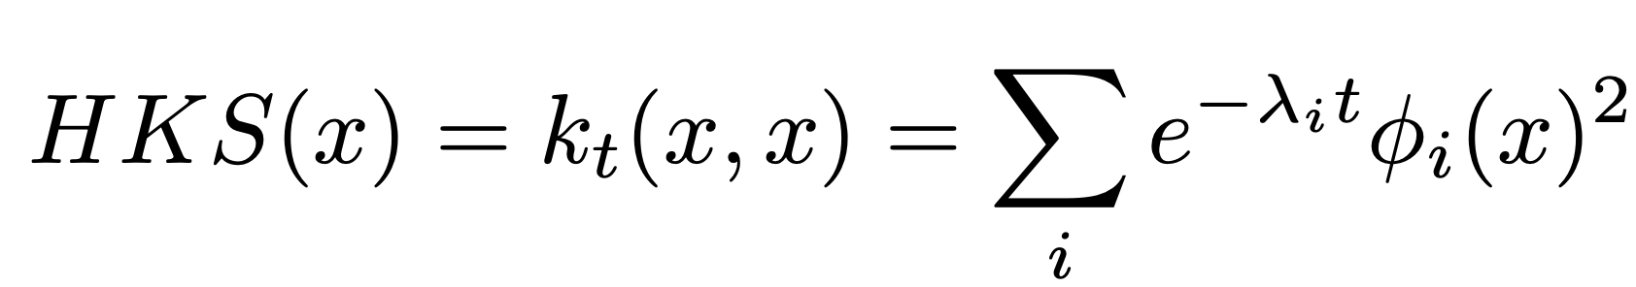
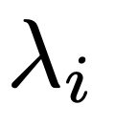
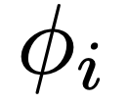
Heat Kernel Signature
: i-th eigenvalue of the Laplacian
: i-th eigenfunction of the Laplacian
Image from ] Jian Sun, Maks Ovsjanikov, and Leonidas Guibas. “A concise and provably informative multi-scale sig- nature based on heat diffusion”. In: vol. 28. 2009.
Notes:
Bottom pictures: points in blue areas have similar heat kernel signature, left: small t, right: large t
invariant under isometric deformations so also rotations and can be computed efficiently.

Slide 15
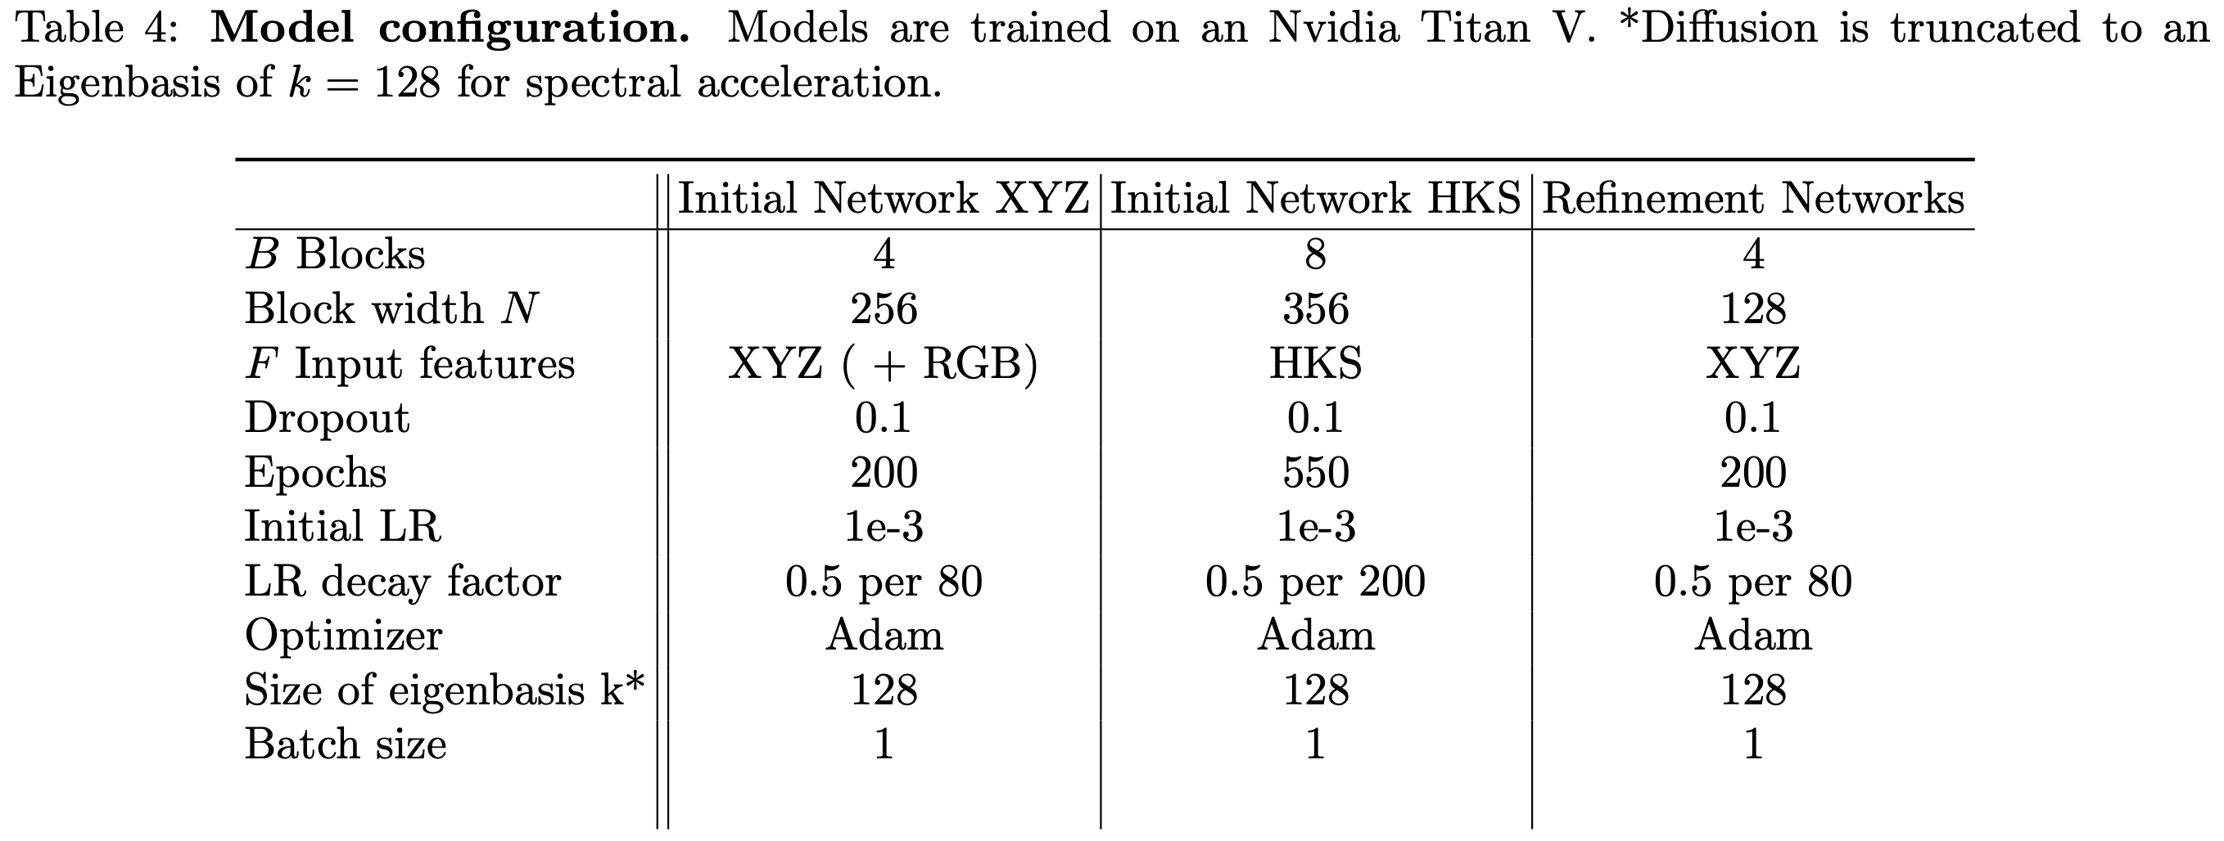
Training
Notes:
Choose model with best validation score, but test on separate test set to prevent overfitting on validation set

Slide 16
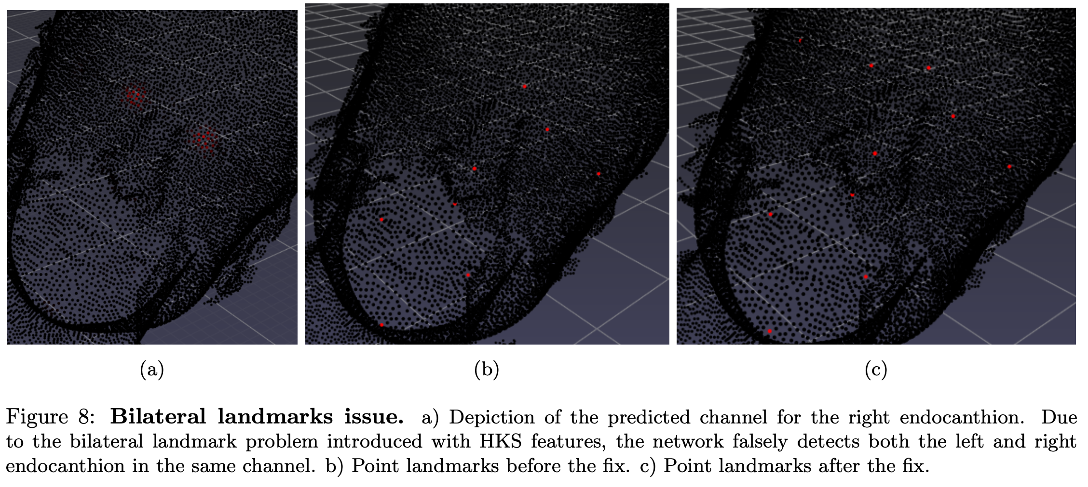
Bilateral Landmark Issue (for HKS)

Slide 17
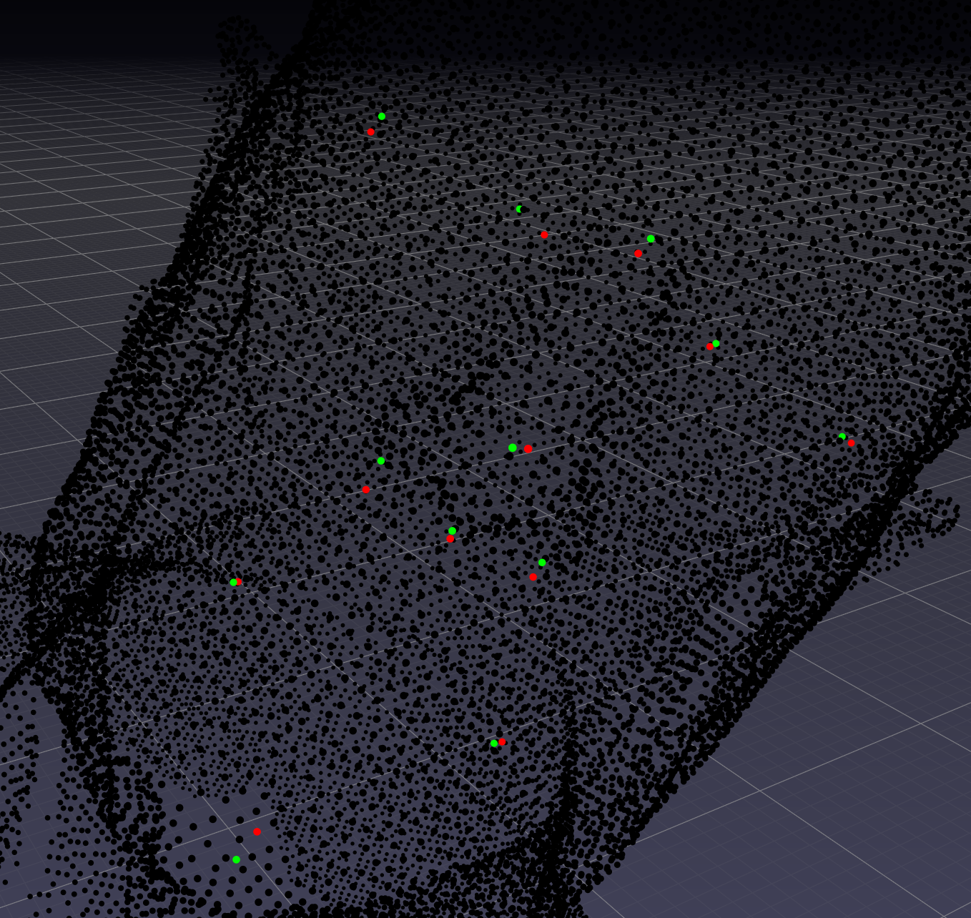
Result Example
Sample mean error ± std in mm: 2.91 ± 1.55
Pogonion: 5.03
Nasion: 2.89
Pronasale: 2.01
Alar curvature r.: 5.24
Subnasale: 1.68
Alar curvature l.: 2.61
Exocanthion r.: 3.05
Endocanthion r.: 5.55
Endocanthion l.: 1.14
Exocanthion l.: 3.39
Cheilion r.: 0.99
Cheilion l.: 1.37

Slide 18
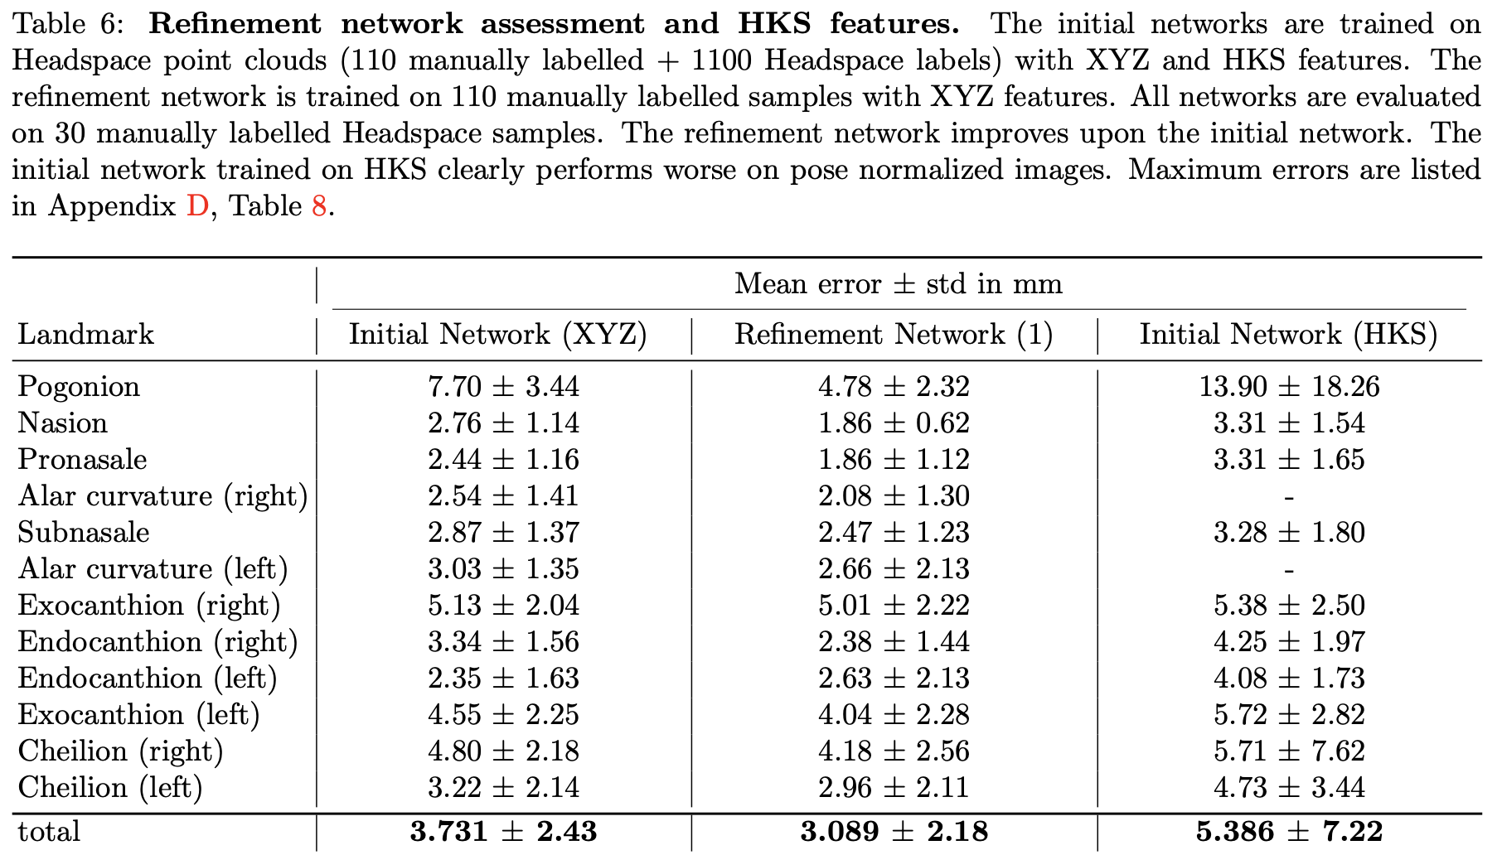
Results

Slide 19
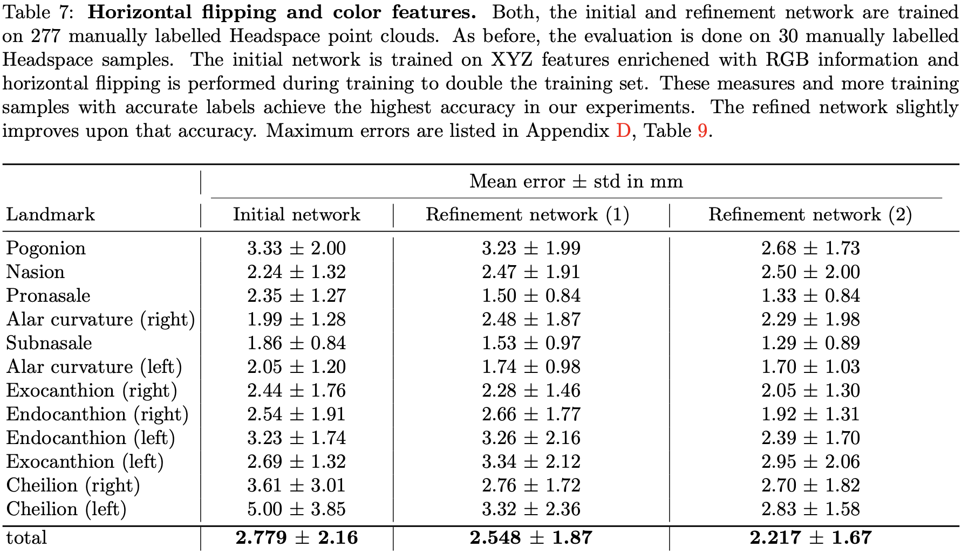
Results

Slide 20
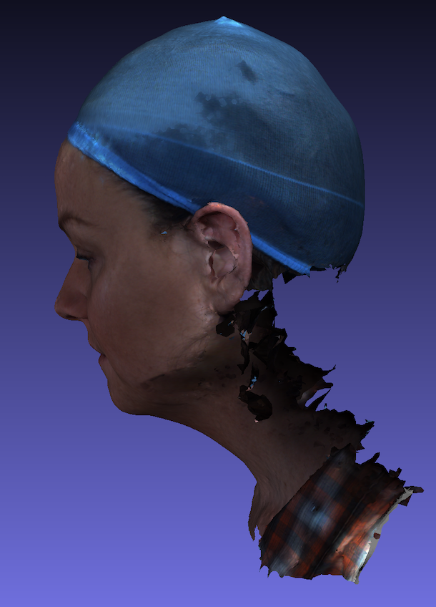
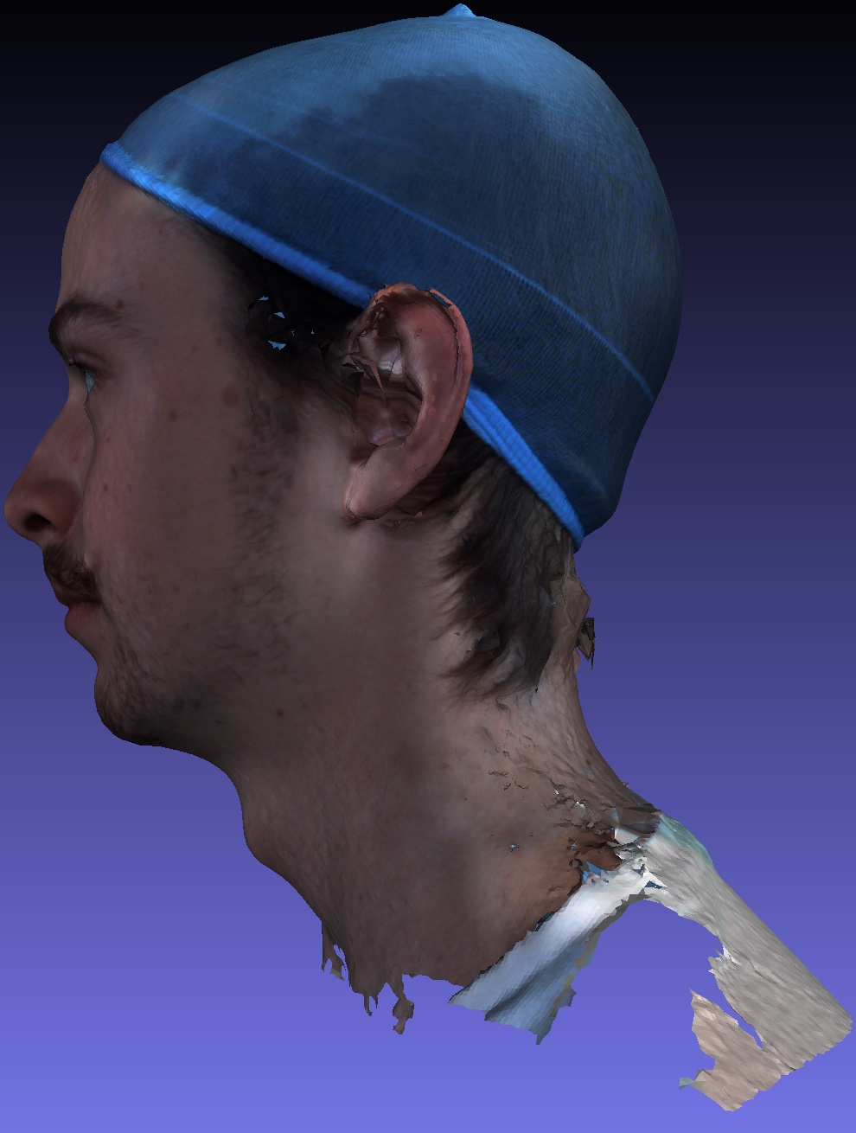
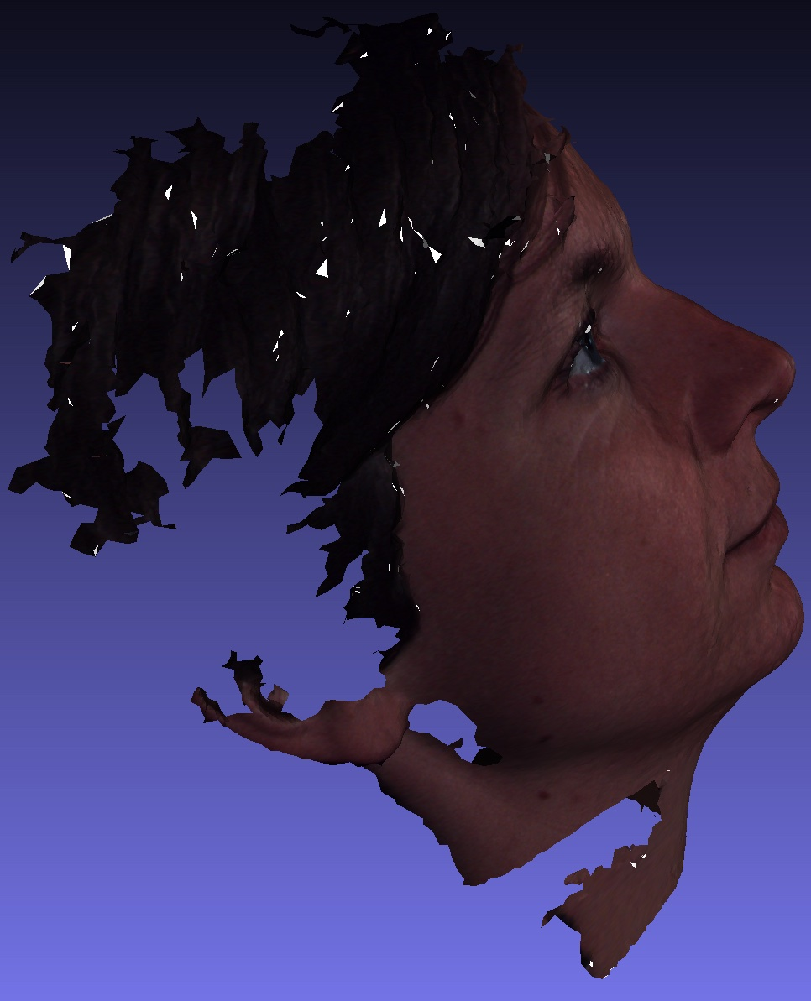
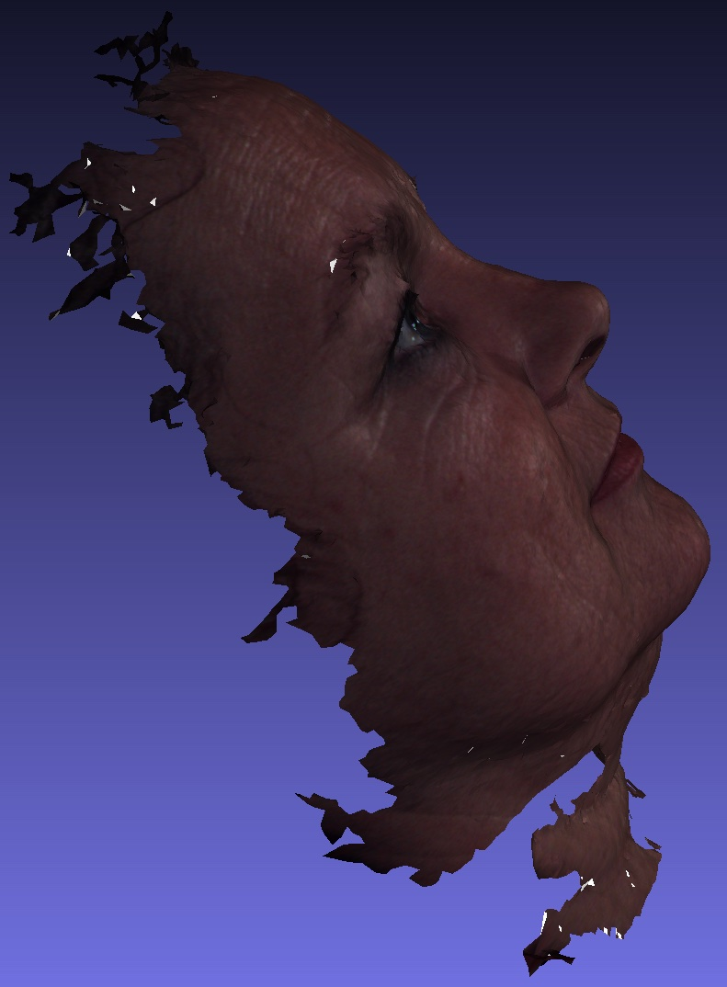
Headspace UMC Controls

Slide 21
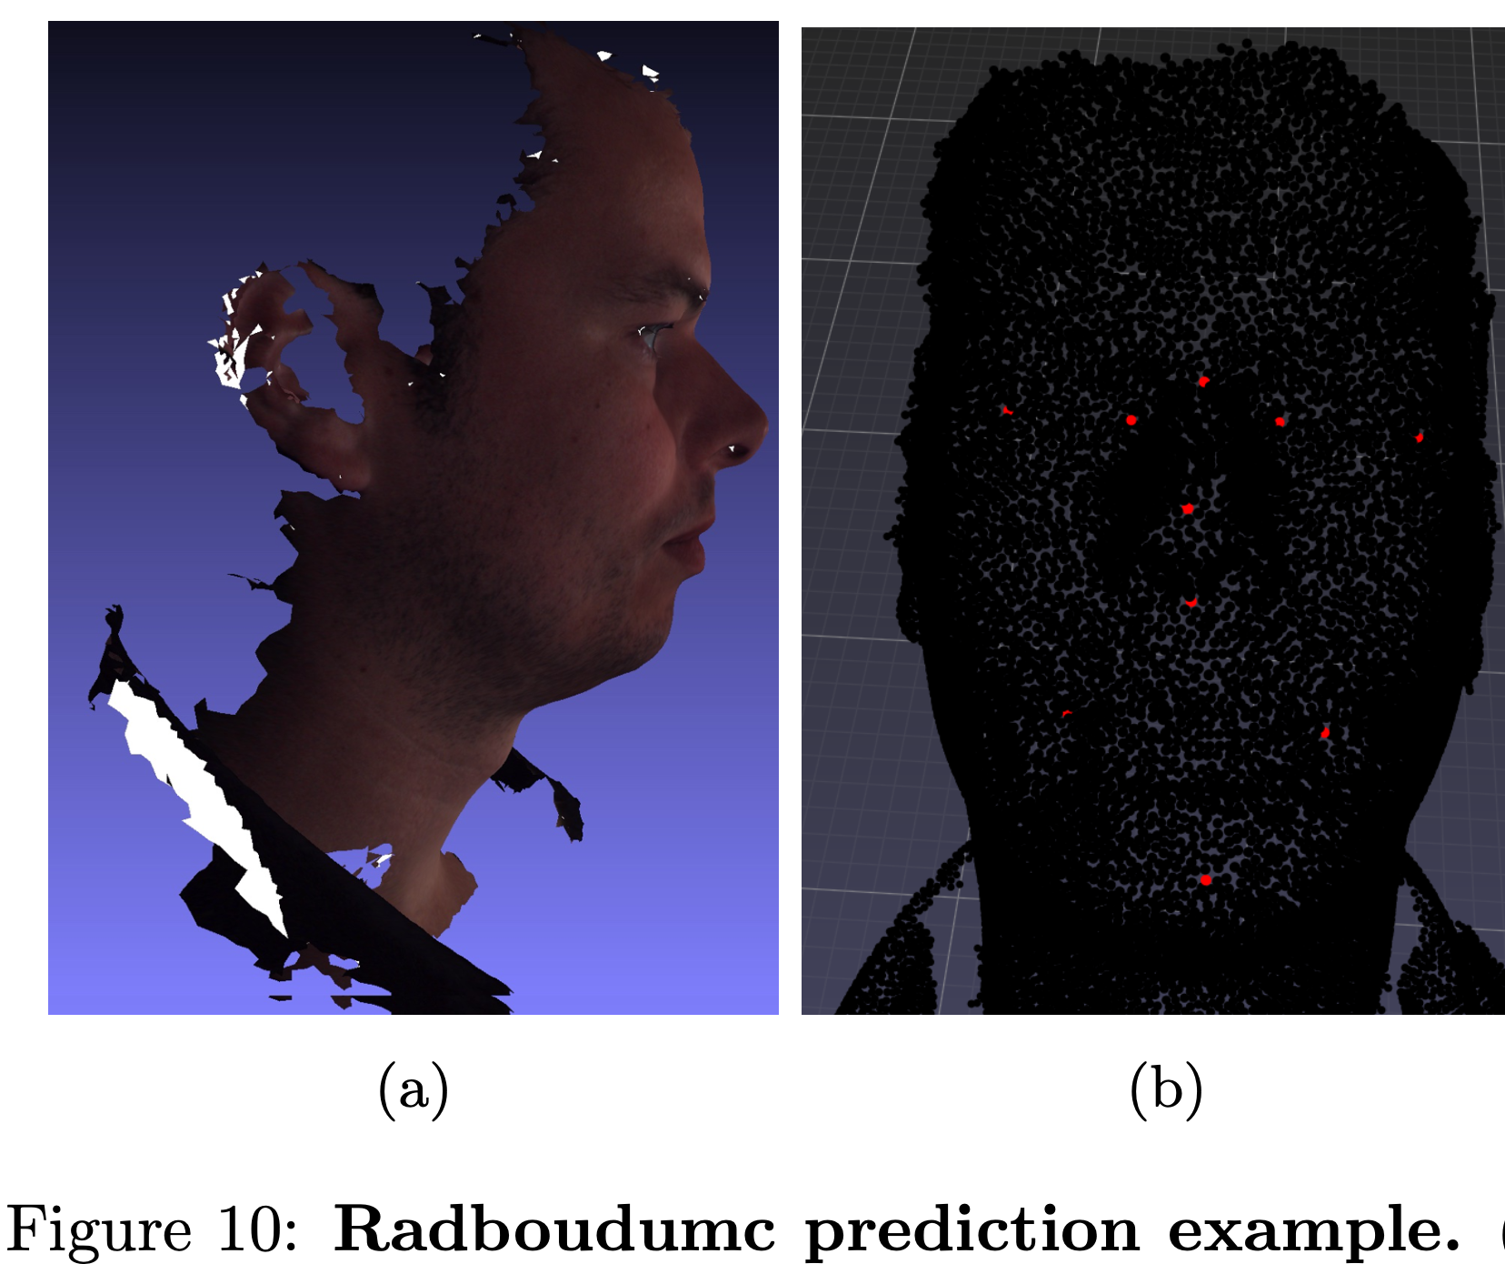
UMC Control Prediction (with HKS)
regions
Notes:
HKS entirely invariant to rotation

Slide 22
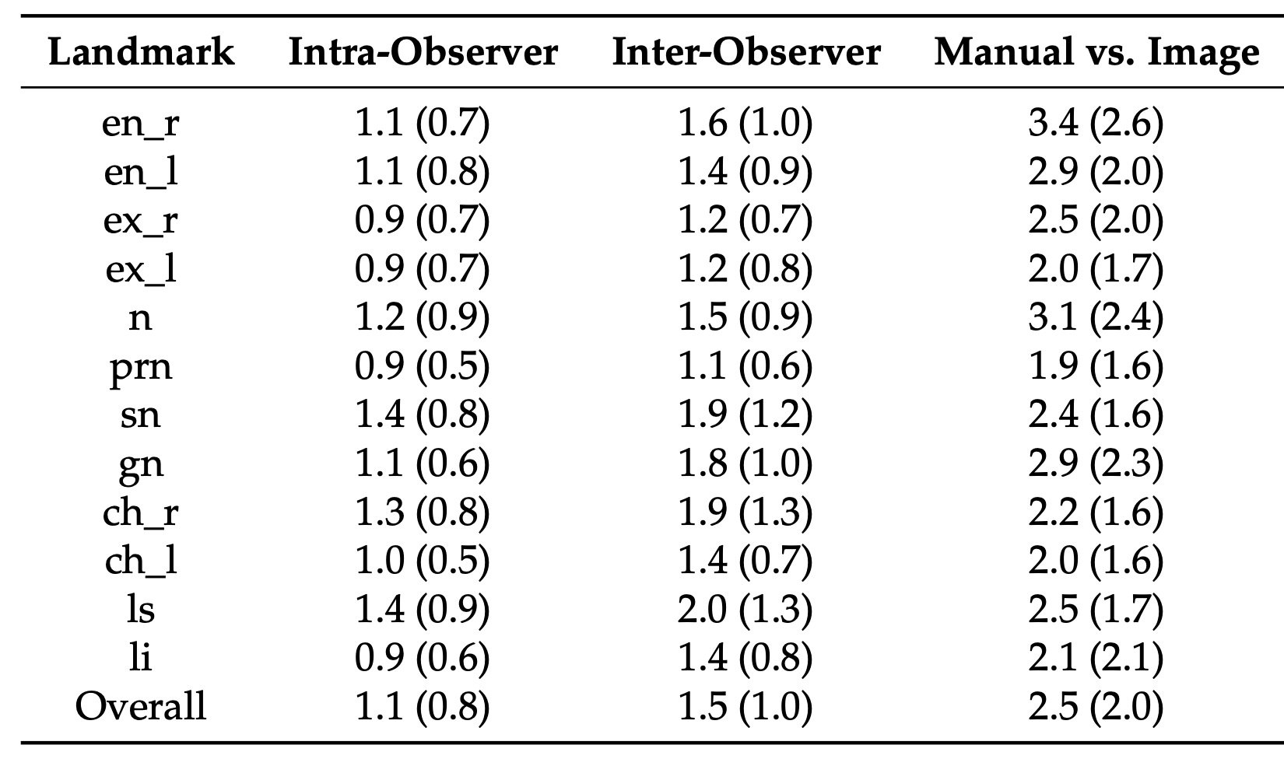
Conclusion
Landmark detection network based on DiffusionNet
Refinement model improves accuracy
2.2mm accuracy for pose-normalized point clouds
Does not reach human-level performance (1.1mm)
Bannister et al. Ours
1.92 (1.73)
2.39 (1.70)
2.05 (1.30)
2.95 (2.06)
2.50 (2.00)
1.33 (0.84)
1.29 (0.89)
-
2.70 (1.82)
2.83 (1.82)
-
-
2.22 (1.67)
Jordan J. Bannister et al. “Fully automatic landmarking of syndromic 3D facial surface scans using 2D images”. In: Sensors (Switzerland) 20 (11 2020). issn: 14248220. doi: 10.3390/s20113171.
Notes:
DiffusionNet strong features: sampling, resolution, representation independence (experiments show no true invariance to representation and resolution, but robustness)
Trained on 277 samples, annotations suffer from inter-observer variability (previous research showed measured 1.5), training on more samples likely improve accuracy

Slide 23
Limitations & Future Work
Pre-computation of operators time-consuming, accelerate by parallelization
HKS features better for non-prealigned faces in the wild
Poor performance
Initial Network HKS -> prealign -> Refinement Network XYZ
Include faces (2-camera-setup) in training set
Fix bilaterial landmark issue on network-level
Notes:
Building gradients is accelerated by CUDA, other operators not yet
HKS not fully converged, 8 instead of 4 diffusionnet blocks, wider networks seems to help, maybe even larger?

Slide 24
Thank you for your attention

Slide 25
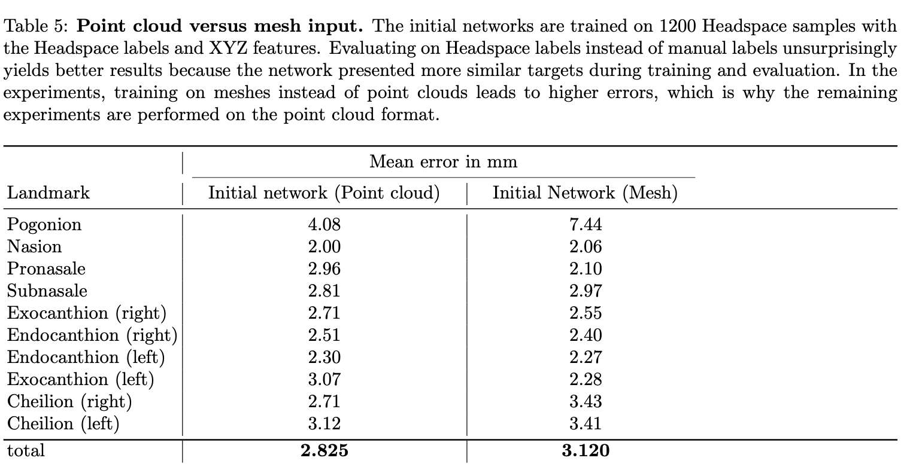

Slide 26
